Slide 1
Fundamental learnings on the skin microbiome and metabolome of pre-aging in Chinese female
Yanyun Ma¹, Mengjia Xu², Yizhou Liu¹, Yueying Fu², Cecilia Li², Weilin Pu¹
1. School of Life Sciences, Fudan University, Shanghai, China
2. Johnson & Johnson China Ltd., Shanghai, China
Disclosures: This work was sponsored by Johnson & Johnson Consumer Inc. a subsidiary of Kenvue
Author Disclosures TBC

Slide 2

Objective, Methods & Material
Introduction, Objectives, and Methods
Introduction
Photoaging, fine lines, sebum excretion rate, wrinkle, wrinkle area, and skin roughness are identified as the pre-aging indicators for 18-30 age group in our previous study.
Objectives
This current study expands on understanding the skin microbiome, metabolomics, and establishment of biomarkers in identifying the potential shift from pre-aging to aging skin.
Methods
Pre-aging bio-marker identification
Used cotton swabs of forehead to collect the flora of facial skin
Used D-squames of forehead to collect the skin metabolites
DNA extraction and metagenome sequencing will be performed to get the microbiome data
After metabolite extraction, untargeted metabolomics will be performed to get metabolome data
18-30yrs (G1-G2) vs 31-60yrs (G3-G6)
The composition of species abundance was constructed based on CANOPY algorithm¹
18-30yrs (G1-G2) vs 31-60yrs (G3-G6)
OPLS-DA differential analysis for lipid biomarkers in two different age groups
18-30yrs (G1-G2) vs 31-60yrs (G3-G6)
used LEfSe analysis² to identify pre-aging biomarker
18-30yrs (G1-G2) vs 31-60yrs (G3-G6)
PERMUTATIONS-TEST between two age groups shows the lipids of the older group can be differentiated from the younger group significantly
Group | Age | Number
G1 | 18-25 | 27
G2 | 26-30 | 25
G3 | 31-35 | 24
G4 | 36-40 | 33
G5 | 41-50 | 30
G6 | 51-60 | 25
164 healthy women
Shanghai
1.CANOPY algorithm - Based on gene abundance, genes with a high degree of uniform variation are brought together to form a potential genome
Nielsen HB, Almeida M, Juncker AS, et al. Identification and assembly of genomes and genetic elements in complex metagenomic samples without using reference genomes. Nat Biotechnol. 2014;32(8):822-828. doi:10.1038/nbt.2939
2. LEfSe analysis - LEfSe analysis, also known as LDA Effect Size analysis, can realize the comparison between multiple groups, and also carry out subgroup comparison analysis within the group comparison, so as to find species with significant differences in abundance between groups (biomaker)
Segata N, Izard J, Waldron L, et al. Metagenomic biomarker discovery and explanation[J]. Genome Biol, 2011, 12(6): R60.
Notes:
Introduction
As the global aging population increases, research of skin aging is gaining significant attention. Accurate identification of the characteristics of pre-aging is the key to achieving delayed aging (Anwar, et al., 2022). The aim of this study is to establish an assessment method for pre-aging in Chinese women, thus realising the possibility of precise anti-aging in the pre-aging phase.
Methods & Material
164 healthy subjects in Shanghai were recruited in a clinical study,
Separate them into 6 groups, each group has specific age range and 25-35 numbers of participants.
125 skin parameters were assessed for the aging assessment
including clinical evaluation, instrument measurements,
Correlation analysis was conducted between skin parameters with age of 18-60 and 18-30 separately. The intersection of these features was recognized as pre-aging features.
self-assessment questionnaires including life habits and skin pre-aging experience.
Subjects completed a questionnaire on the total time spend or frequency of various external factors such as cooking, outdoor, use of social media, smoking, diet and entertainment. Additionally, the questionnaire included current skin conditions and skin care habits.
Evaluation of exposome was conducted by one-way ANOVA, with clinical pre-aging skin features as dependent variable and lifestyles as independent variables.

Slide 3
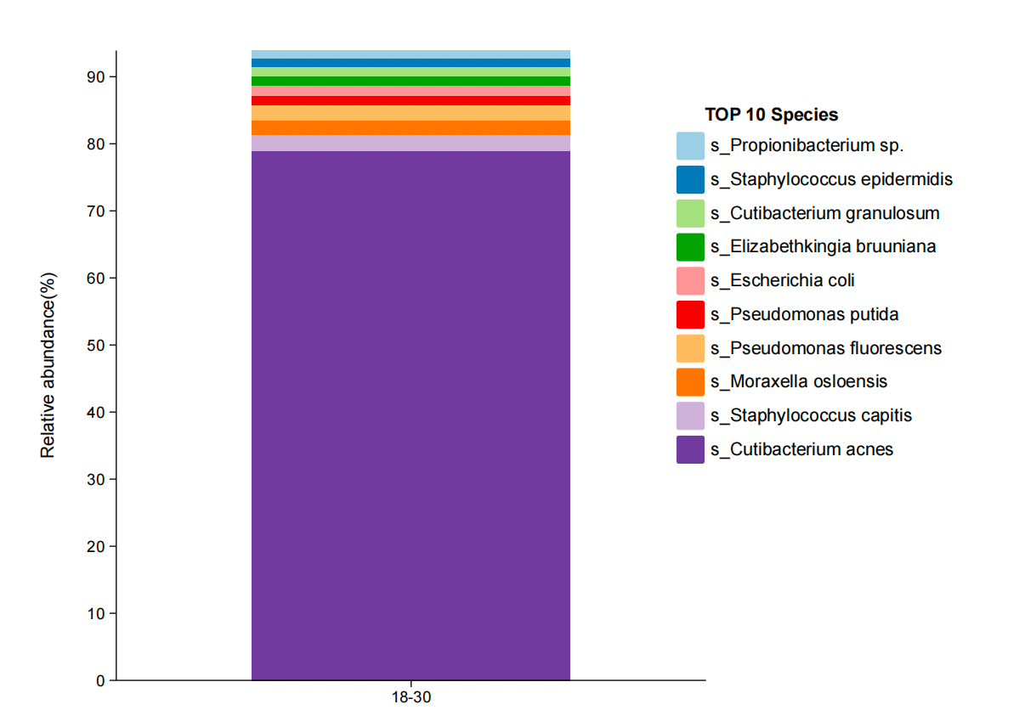
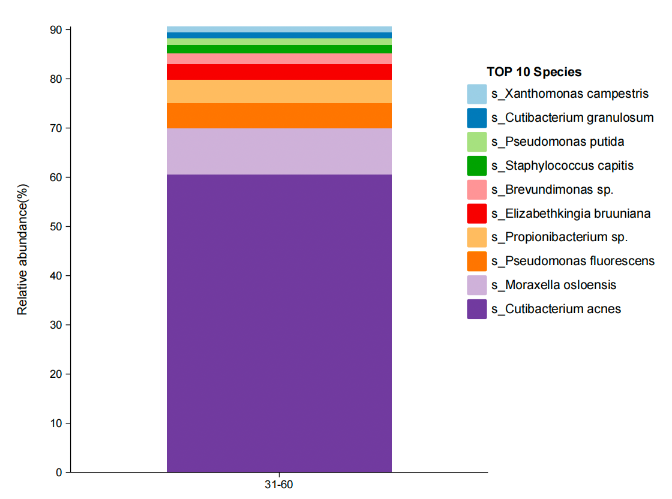
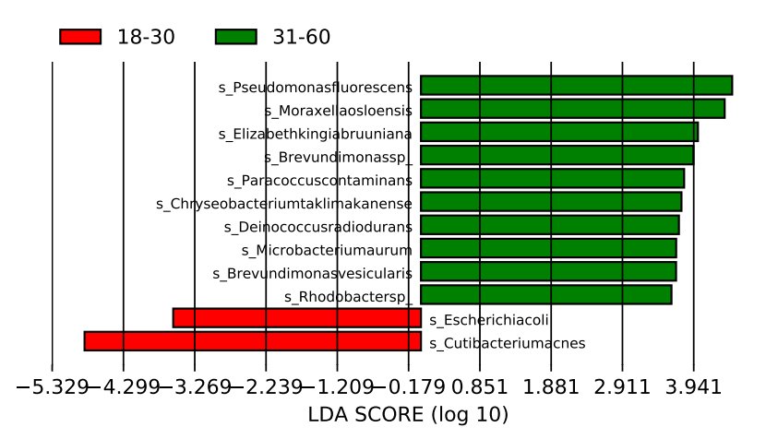
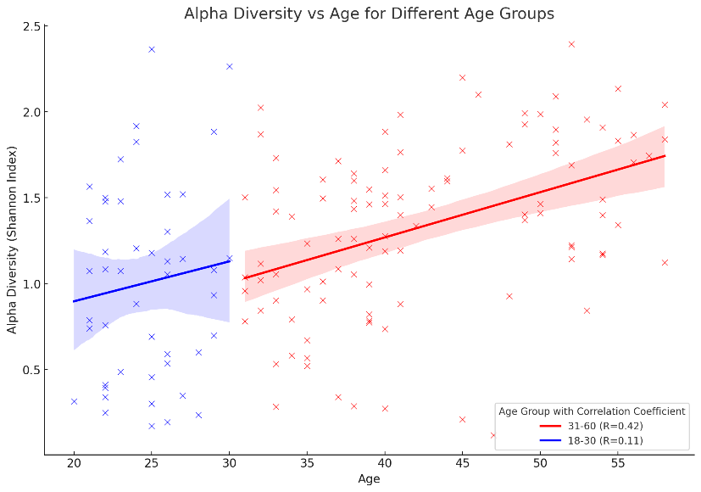
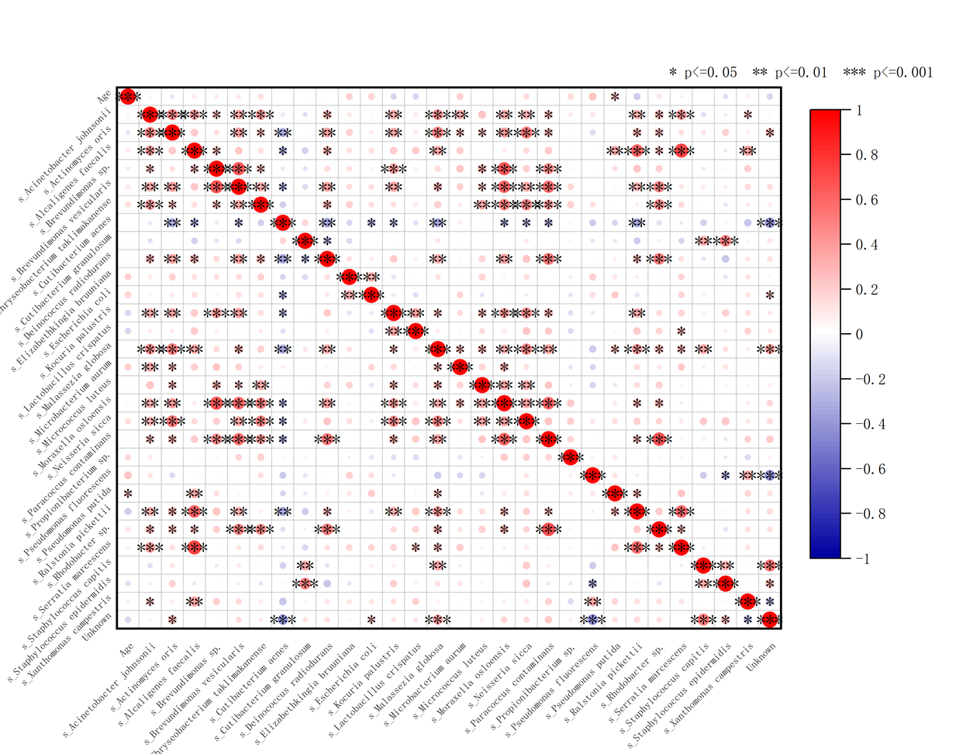
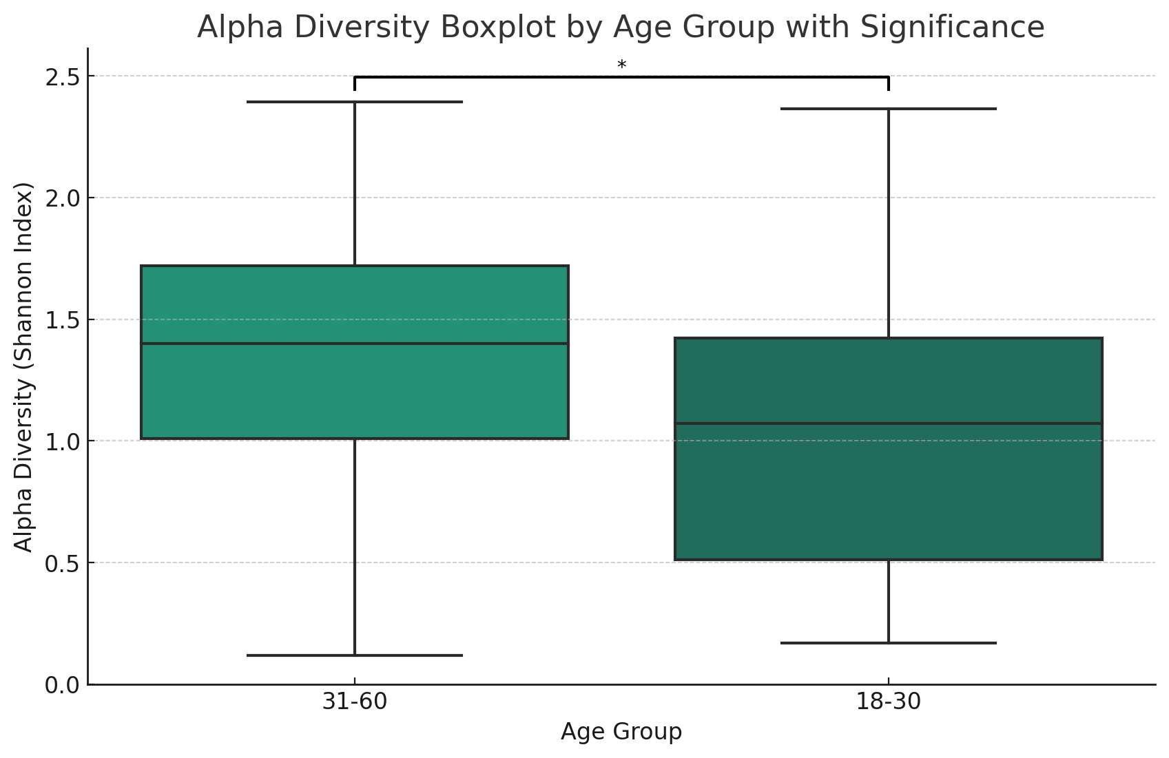
Young individuals tend to have a higher abundance of Cutibacterium acnes, whereas older individuals tend to have a higher abundance of Moraxella osloensis (Fig 2). Additionally, Pseudomonas putida has been found to show a significant association with the chronological age of individuals in the pre-aging stage (Fig 3)
Younger individuals showed a higher prevalence of bacteria C, whereas older individuals tend to have a higher abundance of bacteria M. and bacteria P.
Figure 2. Heat map of microbial species abundance at different ages (all age groups)
Figure 1. Skin microbial diversity in pre-aging and aging group by CANOPY algorithm
Result 1:The microbial composition of the old group and the young group changed, and for the pre-aging group, the dominant micro group were Cutibacterium acnes, Staphylococcus capitis and Moraxella osloensis while Cutibacterium acnes, Moraxella osloensis and Pseudomonas fluoresce dominated in older group. A highly diverse microbial community can improve the stability and resistance to disturbance of an environment or ecosystem, with α(18-30)=1.004 and α(31-60)= 1.336, which indicates the skin microbial community of the pre-aging population was more unstable.
Result2:Cutibacterium aces was up-down-regulated in both groups, while Pseudomonas fuorescens and Moraxella osloensis were significantly up-regulated in the older group.
Result3: LEfSe analysis species with LDA score greater than 2 were shown to have statistically different biomarkers. While older people often had larger abundances of bacteria M and P, younger people demonstrated a higher abundances of bacteria C.
Figure 3. LEfSe analysis to characterize the enriched microbial taxa in different age groups(LDA > 2)
Figure 3. Spearman’s correlation between relative abundances of microbiome and chronological age in younger group (18-35yrs)
18-30没有关联的微生物；
Notes:
facial lotion;
The fluctuation of each type of bacteria is shown in the heat map.

Slide 4
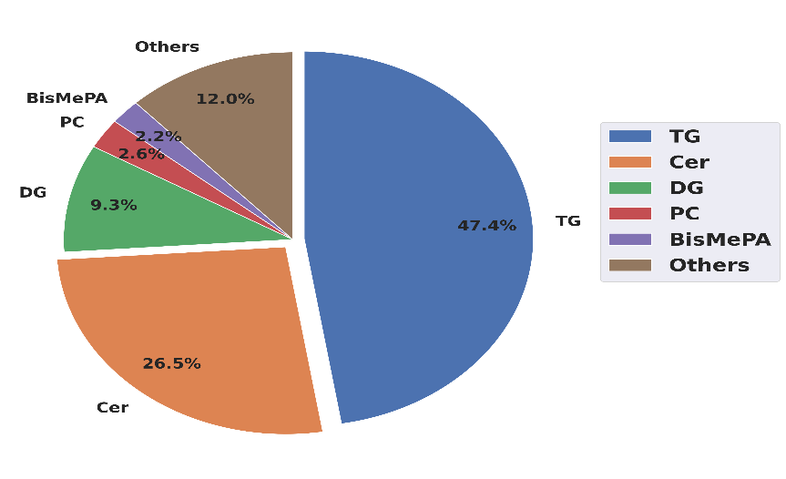
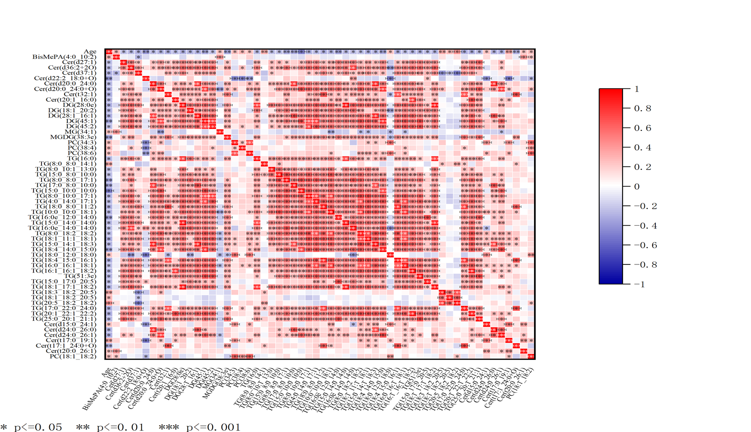
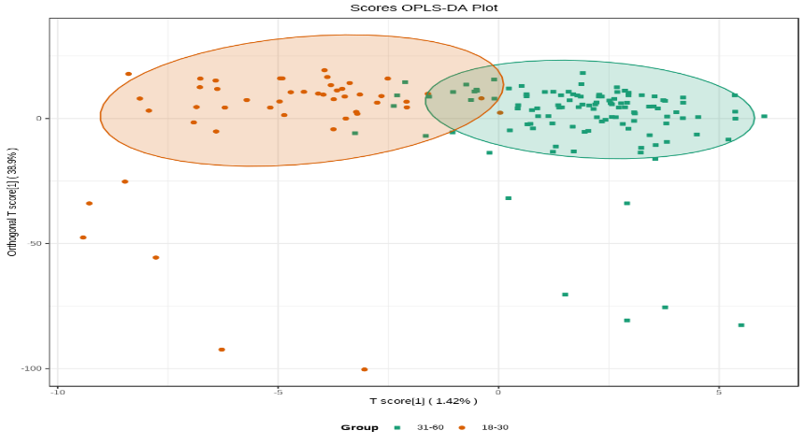
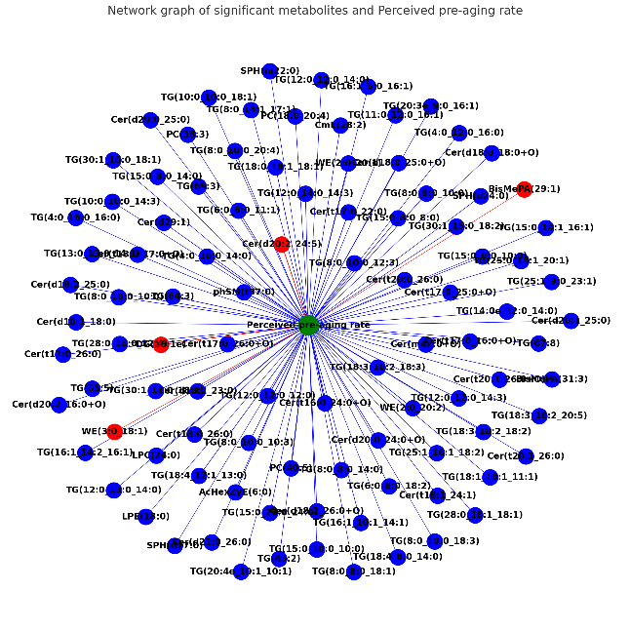
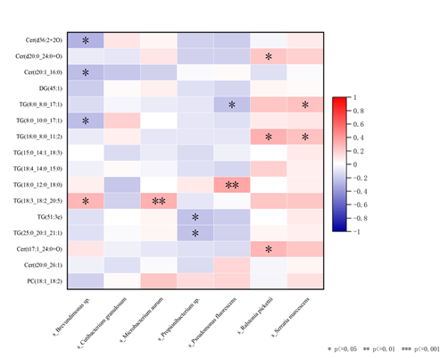
Out of the 1117 lipids analyzed, a total of 57 small lipid molecules were found to have a significant association with chronological age. Among these, Cer(d18:0_18:1), DG(16:1_24:1), and Cer(t18:0_18:2) were identified as potential protective lipids against pre-aging
Ceramides, glycolipids, and diglyceride lipids are significantly higher in the younger group compared to the older group.
Result 1:The Lipid composition of the whole group and TG, Cer, DG, PC were the main components.
Result2: Out of the 1117 lipids analyzed, a total of 57 small lipid molecules were found to have a significant association with chronological age.
Result3:Through OPLS-DA differential analysis for lipid biomarkers in two different age groups, we found lipid levels of the two groups were significantly different on the whole.
Result4:By metabolic difference analysis,, Cer(d18:0_18:1), DG(16:1_24:1), and Cer(t18:0_18:2) were identified as potential pre-aging lipid biomarkers.
Figure 1. Skin Lipid composition of all age groups
Figure 2. Spearman’s correlation between lipids and chronological age in younger group (18-30yrs)
TG: Triglycerides
CER: Ceramides
DG: Diglycerides
PC: Phosphatidylcholines
SPH: Sphingolipids
BisMePA: Bis(monoacylglycero)phosphate
Figure 3. OPLS-DA differential analysis for lipid biomarkers in two different age groups
Figure 4. Composition shift between the younger group and older group (The formula for multiples-old people divided by young people)
Figure 5. Machine learning-based modeling to build relations between microbiome and metabolome

Slide 5
Conclusions
There is significant difference in alpha diversity between the two groups. Younger individuals showed a higher prevalence of bacteria C, whereas older individuals tend to have a higher abundance of bacteria M and bacteria P.
Out of the 1117 lipids analyzed, a total of 57 small lipid molecules were found to have a significant association with chronological age. Based on OPLS-DA model, ceramides, glycolipids, and diglyceride lipids were statistically significantly higher (VIP value >2) in the younger group compared to the older group.
We have drawn the characteristic maps of skin microbiome and metabolomics through data analysis. Our data revealed the differences and progression of the skin microbiome and metabolomics which changes with aging. These findings lay the groundwork for personalized anti-aging interventions specifically targeting the pre-aging phase.
Notes:
PE可提可不提，

Slide 6
Sample figure

Slide 7
Sample table
Table title if needed
Header | Header | Header | Header
Label | XX (X) | XX (X) | XX (X)
Label | XX (X) | XX (X) | XX (X)
Label | XX (X) | XX (X) | XX (X)
Label | XX (X) | XX (X) | XX (X)
Label | XX (X) | XX (X) | XX (X)
Label | XX (X) | XX (X) | XX (X)
Label | XX (X) | XX (X) | XX (X)
Label indented | XX (X) | XX (X) | XX (X)
Label indented | XX (X) | XX (X) | XX (X)
Label indented | XX (X) | XX (X) | XX (X)
Footnote if needed

